Slide 1
SQL Server
Views
In all slides, db=database

Slide 2
Views
A view is basically a stored query.
Views are often used to
  Simplify complex queries
  Filter data
You can SELECT data from one or more tables in a view
Once a view is created, you can use it like a table, joining it to other tables, etc.

Slide 3

Simple View Syntax

Slide 4
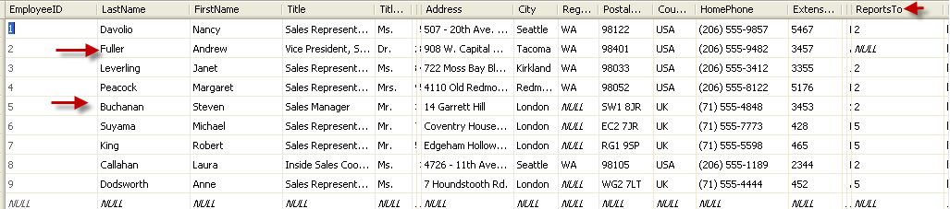
Sample Views
Try it out!
Can you create a view called Managers in the Northwind database that shows only employees that supervise other employees?

Slide 5

View Syntax
USE Northwind
Go
CREATE VIEW Managers
as
SELECT LastName,FirstName, Title, TitleofCourtesy FROM Employees as sup
WHERE EXISTS (SELECT EmployeeID FROM Employees as s WHERE s.ReportsTo = sup.EmployeeID)

Slide 6
Views cont.
There isn’t anything special done for a view. The view runs just as if it were a query run from the command line—there is no pre-optimization of any kind.
This means that you are adding one more layer of overhead between the request for data and the data being delivered. That means that a view is never going to run as fast as if you had just run the underlying SELECT statement directly.

Slide 7
Views cont.
Why would you use a view?
To simplify very complex queries to be run by someone who is not as familiar with either the data itself or how to produce the complex query.
To apply a level of security. You can allow a user only access to a particular view, but not to the table itself, thus giving them only a specific “view” of the data.

Slide 8
Views cont.
You can liken a view to a derived table in that it hides the select statement used to produce the results. The results of the query are then used just like a table.

Slide 9
Views as Filters
Views are the same as SELECT statements – when we want to filter data, we just use a WHERE clause:
CREATE VIEW CurrentEmployees_vw
AS
SELECT EmployeeID,
FirstName,
MiddleInitial,
LastName,
Title,
HireDate,
ManagerEmpID,
Department
FROM Employees
WHERE TerminationDate IS NULL

Slide 10
Complex Views
USE Northwind
GO
CREATE VIEW CustomerOrders_vw
AS
SELECT cu.CompanyName,
o.OrderID,
o.OrderDate,
od.ProductID,
p.ProductName,
od.Quantity,
od.UnitPrice,
od.Quantity * od.UnitPrice AS ExtendedPrice
FROM Customers AS cu
INNER JOIN Orders AS o
ON cu.CustomerID = o.CustomerID
INNER JOIN [Order Details] AS od
ON o.OrderID = od.OrderID
INNER JOIN Products AS p
ON od.ProductID = p.ProductID
You can easily
make a complex
query into a view.
This query will
return what orders
have been placed
for parts and who
placed them.

Slide 11
Complex Views cont’d
Consider that we want to change that view that we just created to return order information for only yesterday’s orders
We can add a WHERE clause that says “only return the rows where the order date is equal to yesterday”

Slide 12
Complex Views
USE Northwind
GO
CREATE VIEW CustomerOrders_vw
AS
SELECT cu.CompanyName,
o.OrderID,
o.OrderDate,
od.ProductID,
p.ProductName,
od.Quantity,
od.UnitPrice,
od.Quantity * od.UnitPrice AS ExtendedPrice
FROM Customers AS cu
INNER JOIN Orders AS o
ON cu.CustomerID = o.CustomerID
INNER JOIN [Order Details] AS od
ON o.OrderID = od.OrderID
INNER JOIN Products AS p
ON od.ProductID = p.ProductID
WHERE CONVERT(varchar(12), o.OrderDate, 101) = CONVERT(varchar(12), DATEADD(day, -1, GETDATE()), 101)

Slide 13
Insert, Update, Delete on Views
If the view contains a join, you won’t be able to INSERT or DELETE data unless you make use of an INSTEAD OF trigger.
If your view references only a single table, then you can INSERT data using a view without the use of an INSTEAD OF trigger provided all the required fields in the table are exposed in the view or have defaults.

Slide 14
WITH CHECK
This clause, when used, prevents changes that do not meet the view's criteria.
Example: Create a view on database pubs for table authors, that shows the name, phone number and state from all authors from California.
CREATE VIEW dbo.AuthorsCA
AS
SELECT au_id, au_fname, au_lname, phone, state, contract
FROM dbo.authors
WHERE state = 'ca'

Slide 15
WITH CHECK cont.
Updating this view without the WITH CHECK option could update all authors (there would be no more authors from California):
WITH CHECK
will
prevent
that:
UPDATE AuthorsCA SET state='NY'
CREATE VIEW dbo.AuthorsCA2
AS
SELECT au_id, au_fname, au_lname, phone, state, contract
FROM dbo.authors
WHERE state = 'ca'
With Check Option

Slide 16
Dropping Views

Slide 17
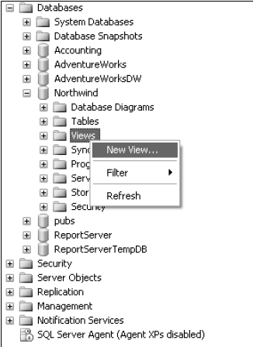
Views in Management Studio
Open up the Northwind database sub-node of the Databases node and right-click on Views.

Slide 18
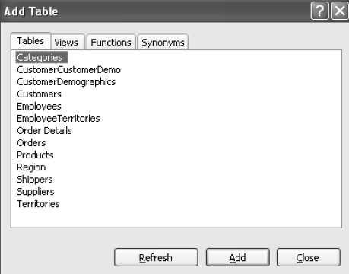
Views in Management Studio cont.
This dialog makes it easy for us to choose what tables we’re going to be including data from.

Slide 19
Views in Management Studio cont.
To select more than one table at a time, hold down the ctrl key while selecting all the tables that are to be included.

Slide 20
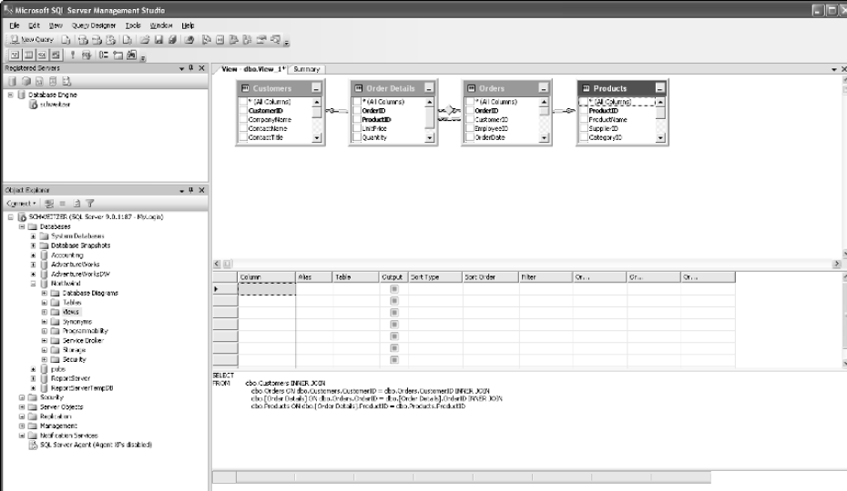
The VIEW editor

Slide 21
The VIEW editor cont.
Four panes in the view editor:
  Diagram Pane
  Criteria Pane
  SQL Pane
  Results Pane

Slide 22
A Few Extras about Views
In general, you cannot use an ORDER BY clause within the definition of the view. However, when you select from a view, you can certainly order the results.
You can see the text of a view from the query window using
sp_helptext viewname
Note that ‘Results in Text’ is an easier way to view this.

Slide 23
Encrypting Views
If you are creating commercial software (i.e. it is sold to a customer), you should consider encrypting your views. This will prevent users from viewing your code.
Note: Once encrypted, there is no way to ‘undo’. You need to keep your code somewhere else so that you can reference it (consider source control as an option).

Slide 24
Encrypting Views
All you have to do to encrypt your view is use the WITH ENCRYPTION option. This one has a couple of tricks to it if you’re used to the WITH CHECK OPTION clause:
WITH ENCRYPTION goes after the name of the view, but before the AS keyword

Slide 25
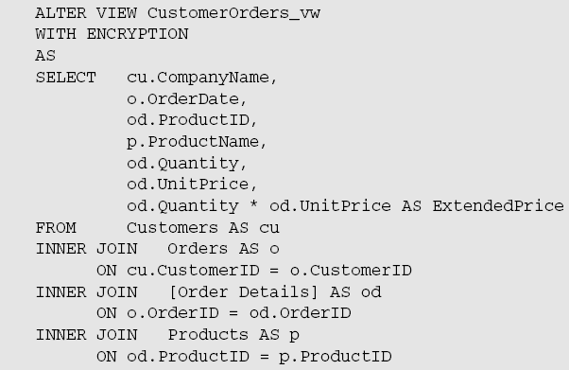
Encrypting Views cont.

Slide 26
Encrypting Views cont.
Now do an sp_helptext on our CustomerOrders_vw:
SQL Server promptly tells us that it can’t do what we’re asking:
Even if you pull it up in other viewers, the code is still safe and secure.

Slide 27
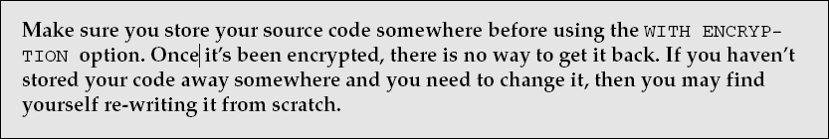
Encrypting Views cont.

Slide 28
Try it!
Add encryption to this query:
CREATE VIEW Managers
as
SELECT LastName,FirstName, Title, TitleofCourtesy FROM Employees as sup
WHERE EXISTS (SELECT EmployeeID FROM Employees as s WHERE s.ReportsTo = sup.EmployeeID)

Slide 29
Solution
ALTER VIEW Managers
WITH ENCRYPTION
as
SELECT LastName,FirstName, Title, TitleofCourtesy FROM Employees as sup
WHERE EXISTS (SELECT EmployeeID FROM Employees as s WHERE s.ReportsTo = sup.EmployeeID)

